Slide 1

Oral presentation
Lúcia
6º F

Slide 2


HELLO!!!
My name is Lúcia and my surname is Soares.

Slide 3


My birthday is on 2nd of November.
I am eleven years old.

Slide 4
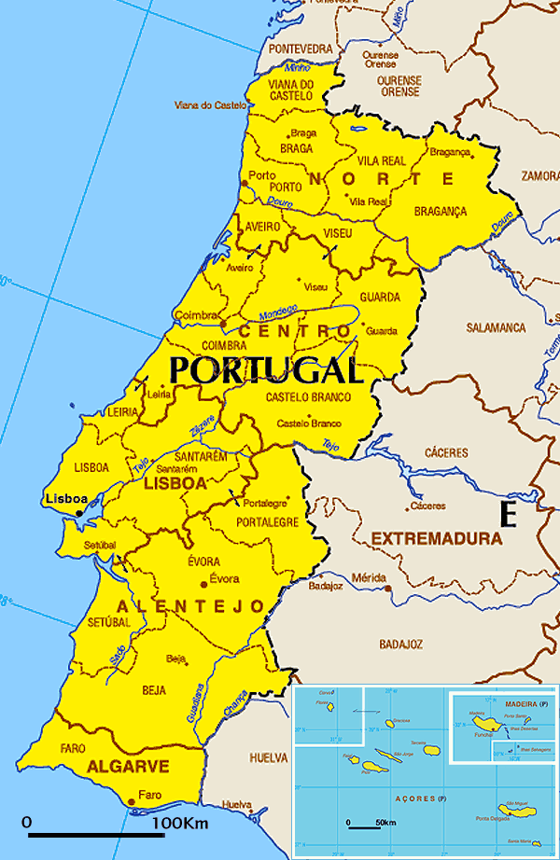
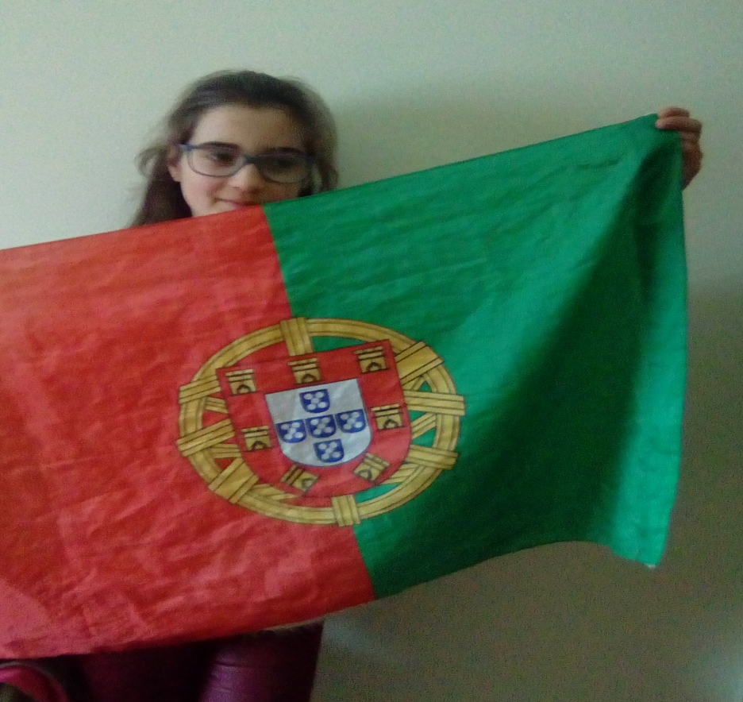
I am from Portugal ,so I’m Portuguese.

Slide 5

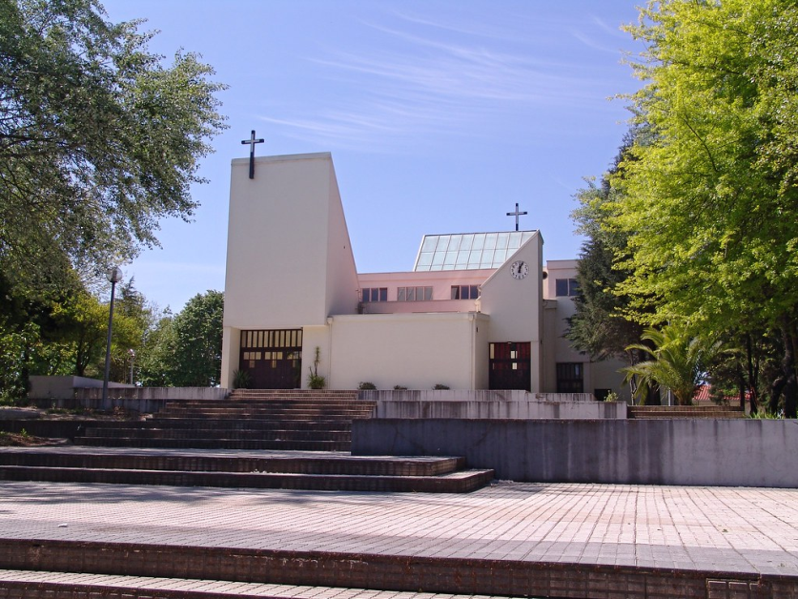
I live in Pindelo.
My address is Leiras street.

Slide 6
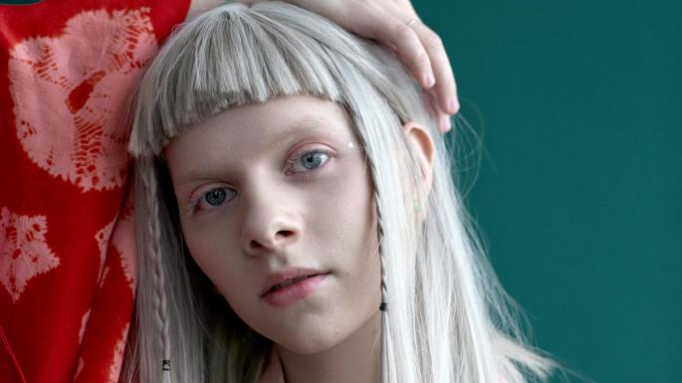
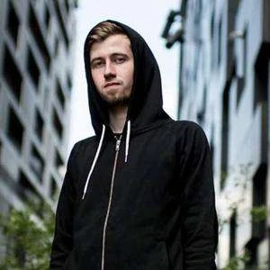
My favorite singers are AURORA and Alan Walker.

Slide 7
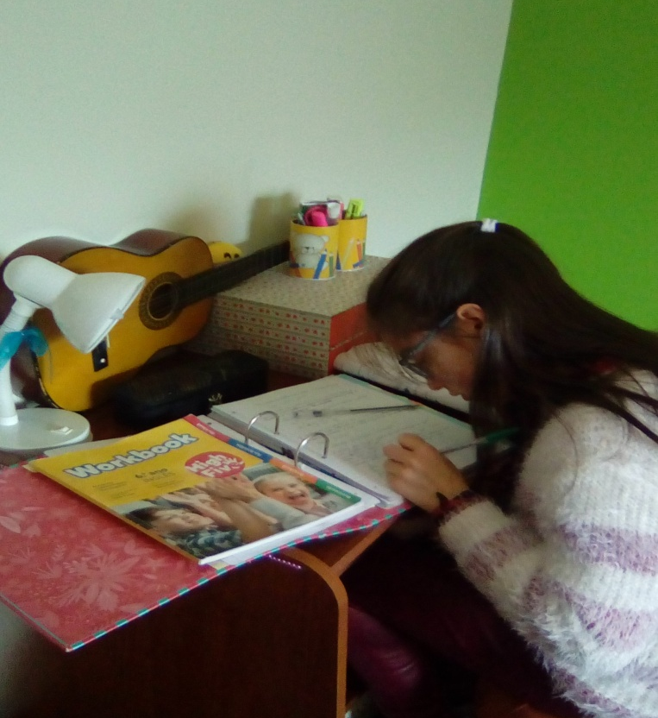
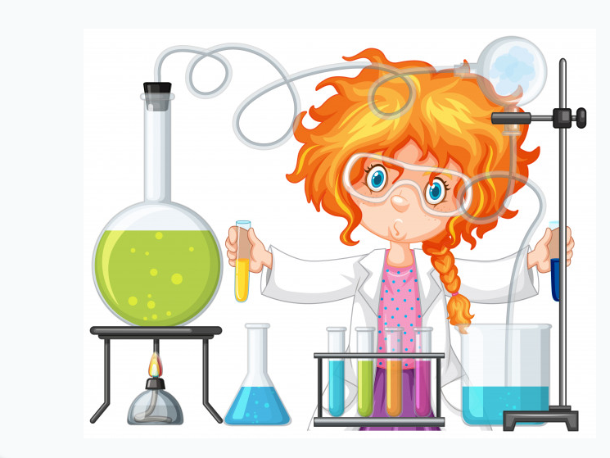
I’m a student.
My favorite subject is science.

Slide 8

I live which my parents and I haven’t got any brothers or sisters.

Slide 9

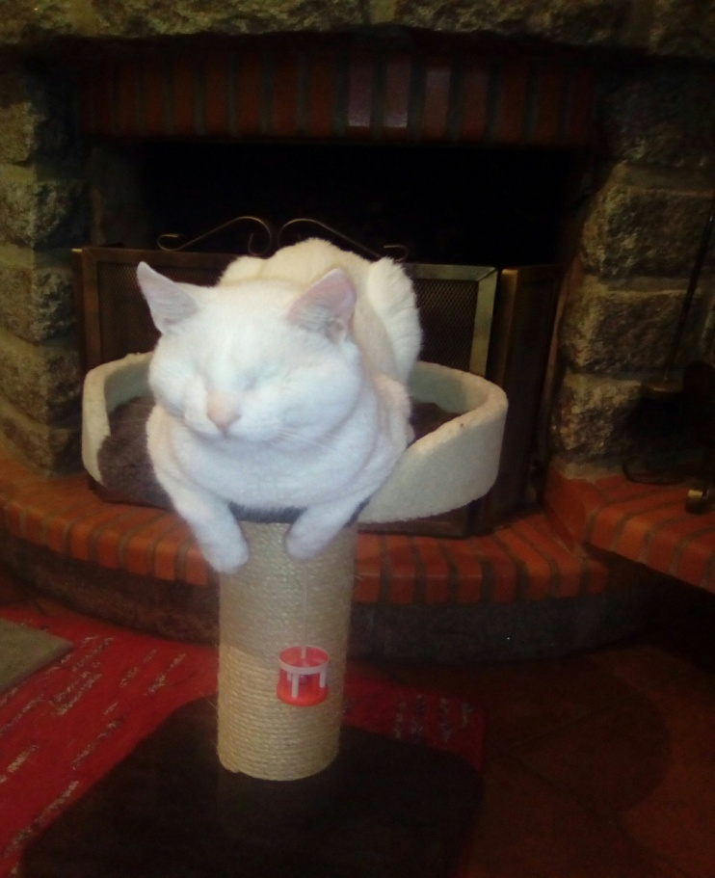
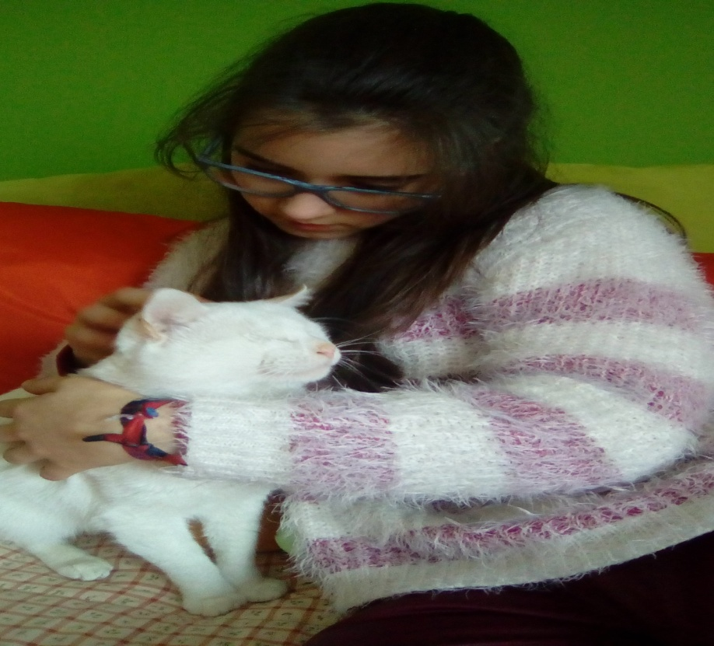
I Have got a pet.
It’s a white cat.

Slide 10

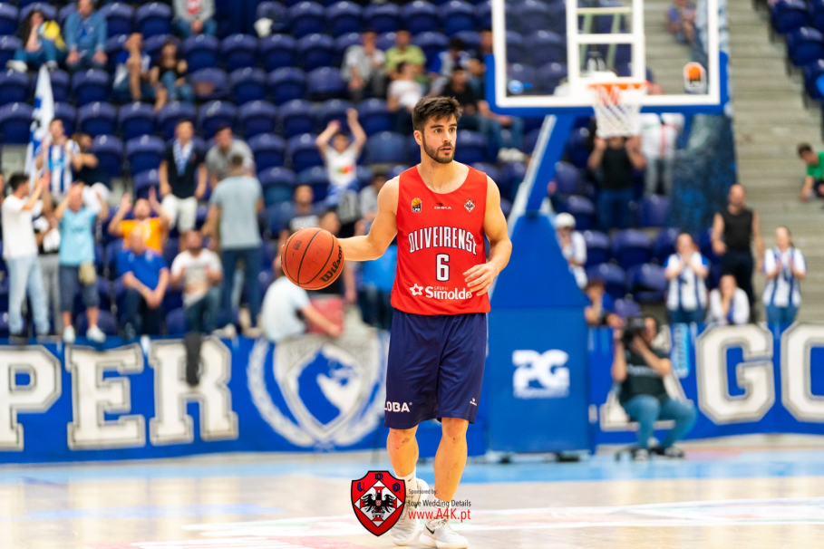
My favorite sport is Basketball.

Slide 11
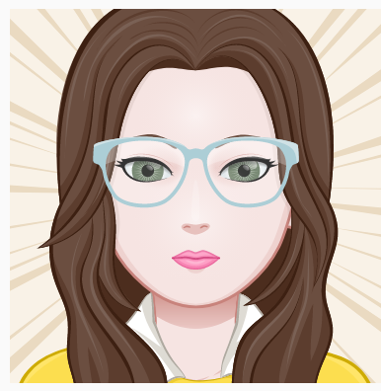

I am slim, tall and I am beautiful.
I have got glasses.
My hair is long, straight and light brown.
My eyes are small and green.

Slide 12



I am polite, funny and happy.

Slide 13


