Slide 1

Oral Presentation
Iara Mendonça 6ºF

Slide 2
Me:
Hi! My name is Iara and my surname is Mendonça.
My birthday is on seventh of March and I’m eleven years old.
I am from Portugal so I am portuguese.
I live in Oliveira de Azeméis with my mom, my two brothers and my stepfather.
I have got a PET. It’s a cat and his name is Tobias.

Slide 3

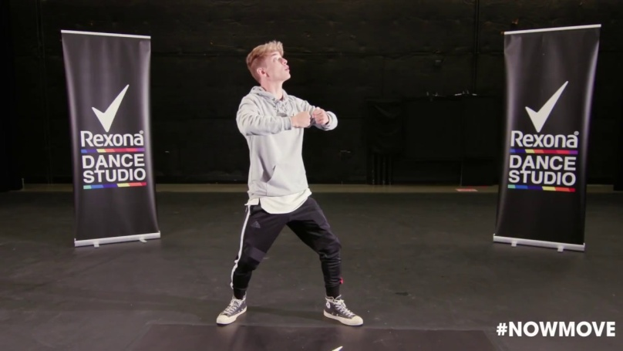
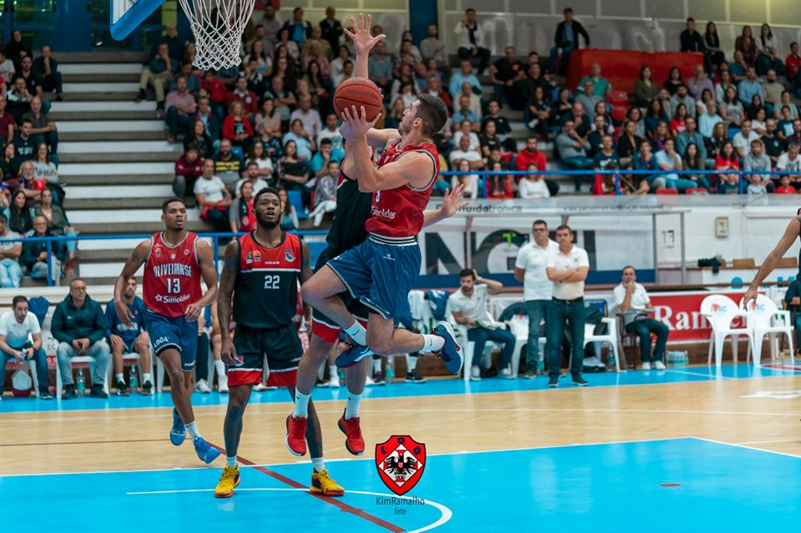
I’m a student and my favourite
subject is English.
My favourite colours
are purple and black.
My favourite sport is dancing but I like basketball too.

Slide 4
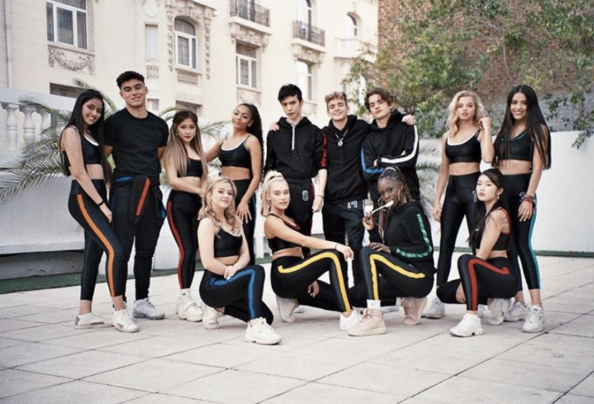
My favourite music group is Now United.

Slide 5

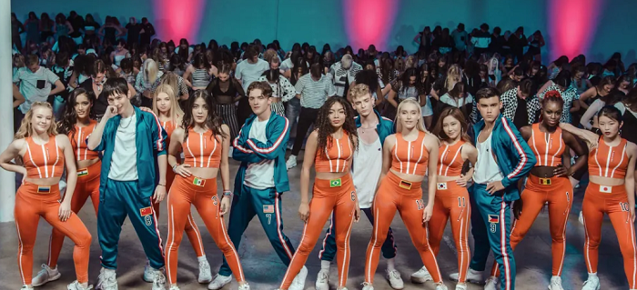
My favourite song are CSSL
(Crazy Stupid Silly Love) and Like That.

Slide 6
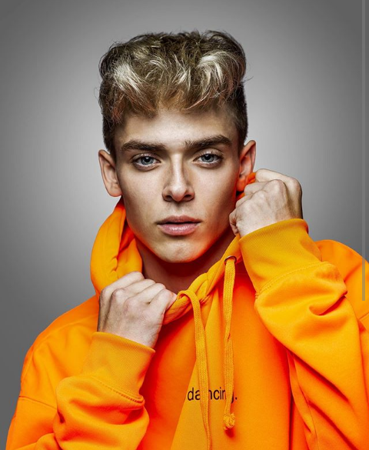
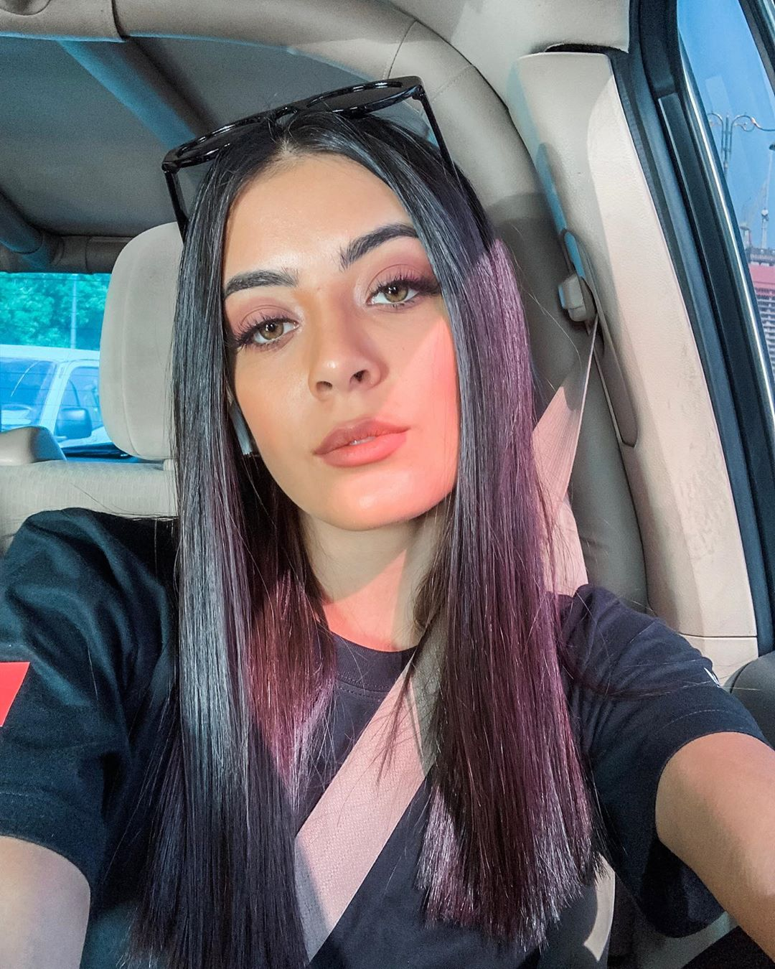
And my favourite members are JOSH and Sabina.

Slide 7
Physical description:
I am tall and slim. I have got brown eyes and long brown hair. I’ve got glasses.
Personality:
Usually I’m friendly, polite and lazy.

Slide 8
My Daily Routine:
I get up at seven o’clock and than I get dressed.
I have breakfast, I brush my teeth and I comb my hair at twenty past seven.
I go to school with my mom and my older brother at half past seven by car.
My classes start at twenty past eight and finish at a quarter past one in the afternoon.
I have lunch in my house at a quarter to two.
After that I brush my teeth again and do my homework.
In the afternoon I watch television and I have a shower.
I have dinner at half past eight with my family.
I go to bed at half past ten when I have classes.

