Slide 1
Clothes, footwear and accessories
Sofia e Lúcia-6F

Slide 2
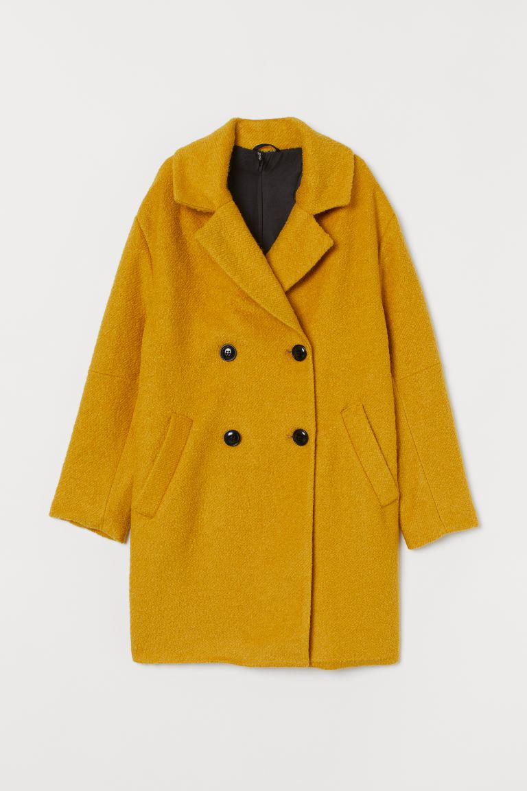
Clothes
Coat

Slide 3
Dress

Slide 4
Jacket

Slide 5
Jeans

Slide 6
Raincoat

Slide 7
Shirt

Slide 8
Shorts

Slide 9
Skirt

Slide 10
Socks

Slide 11
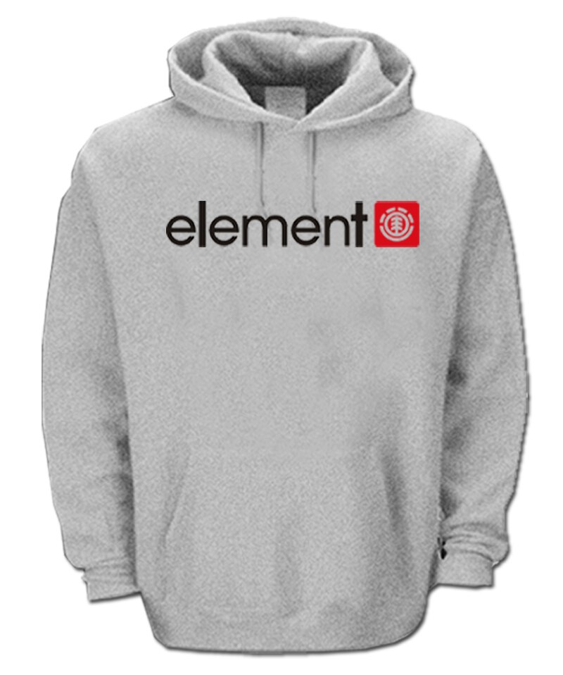
Sweater

Slide 12
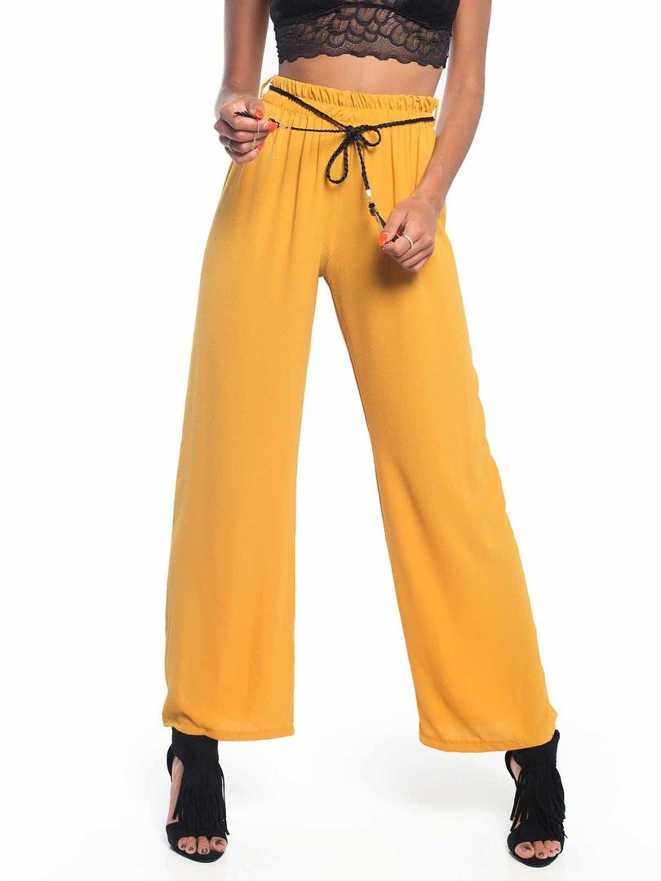
Trousers

Slide 13
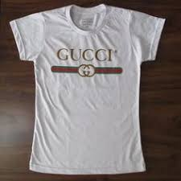
T-shirt

Slide 14
Footwear
Boots

Slide 15
Sandals

Slide 16
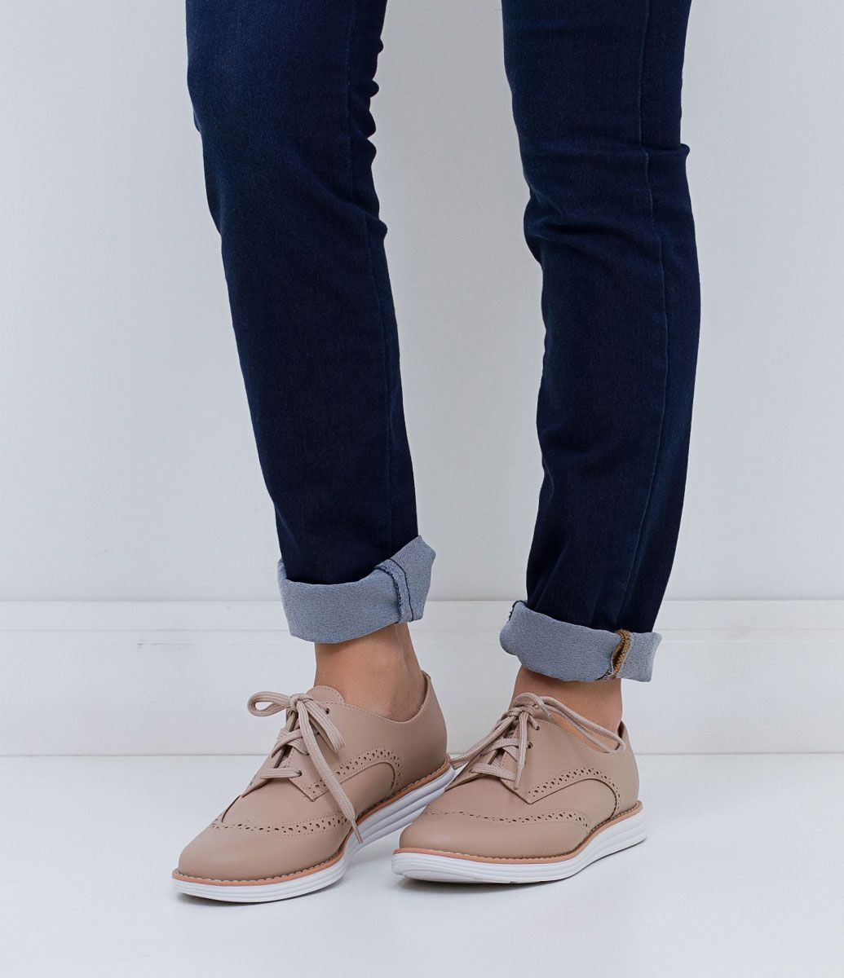
Shoes

Slide 17
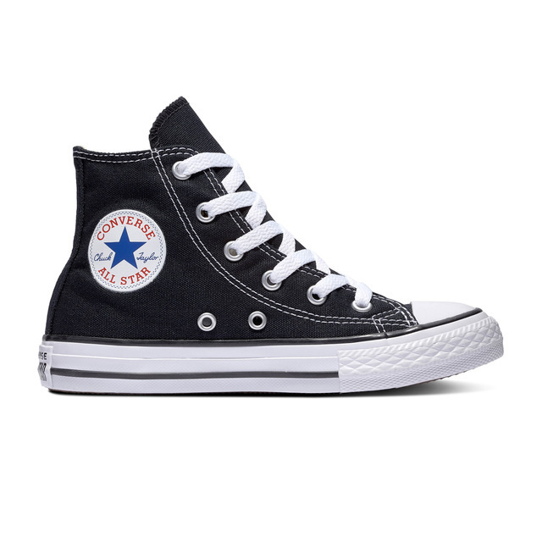
Trainers

Slide 18
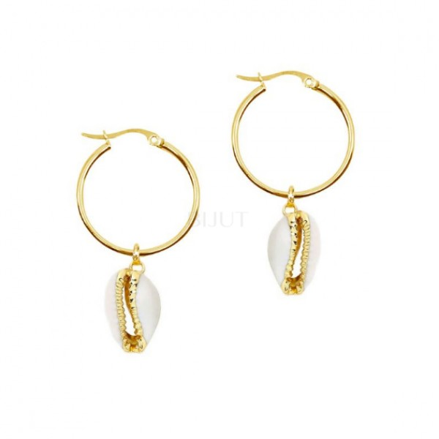
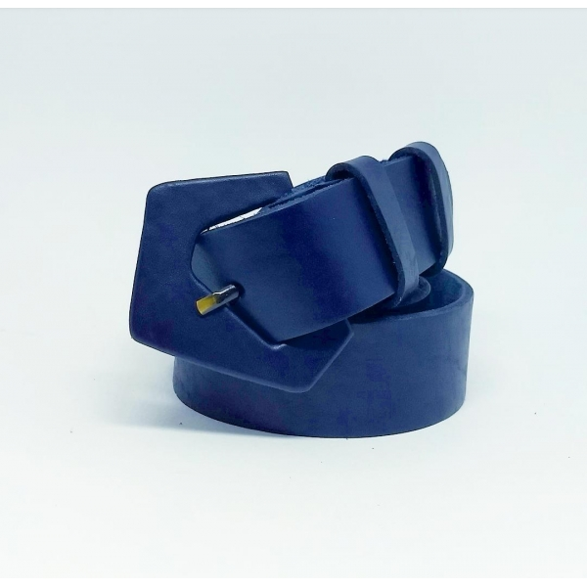
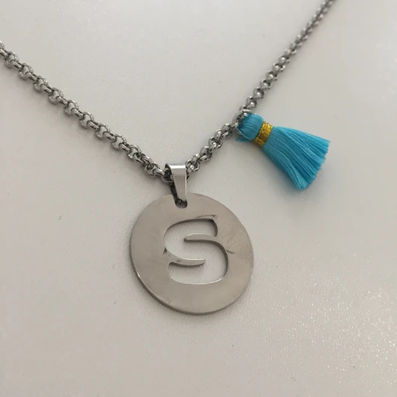
Accessories
Bracelet
Earrings
Necklace
Belt

