Slide 1

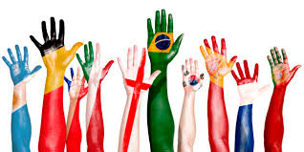
Countries and nationalities

Slide 2
Famous people

Slide 3
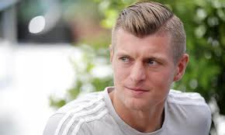

I’m Toni Kroos, and I’m
29 years old.
I’m from , and I’m
Germany
German.

Slide 4
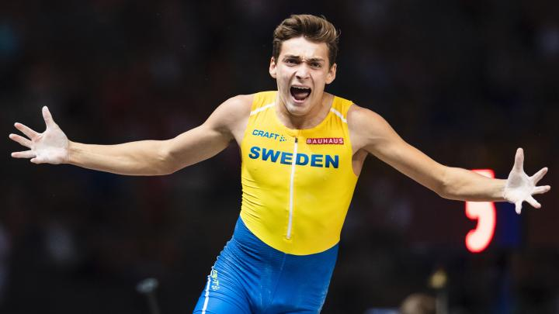

I’m Armando Duplantis and I’m
19 years old.
I’m from and I’m
Sweden
Swedish.

Slide 5
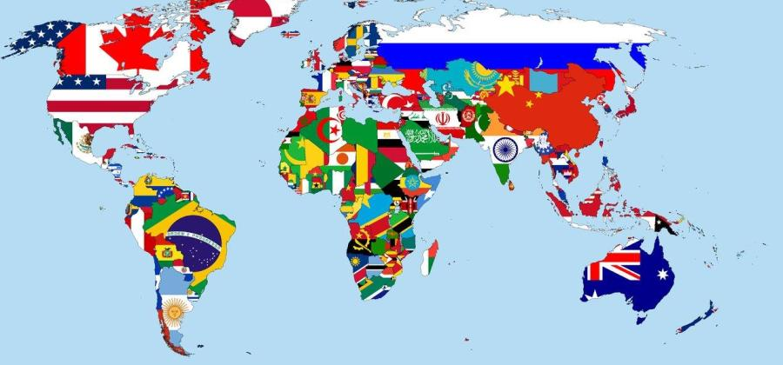
Coutries and nationalities

Slide 6

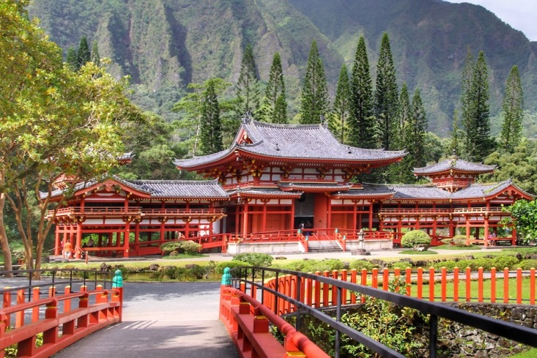
Japan
Country:
Nationality:
Japanese

Slide 7

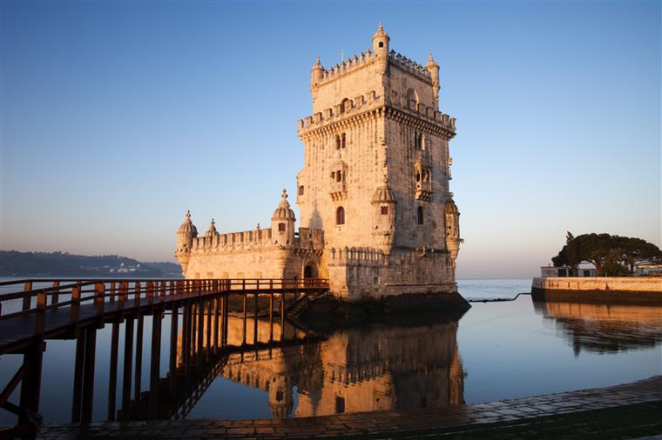
Country:
Nationality:
Portugal
Portuguese

Slide 8

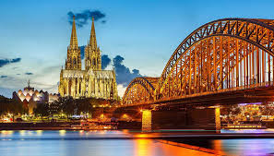
Country:
Nationality:
Germany
German

Slide 9

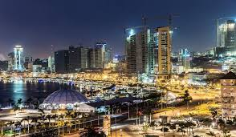
Country:
Nationality:
Angola
Angolan

Slide 10

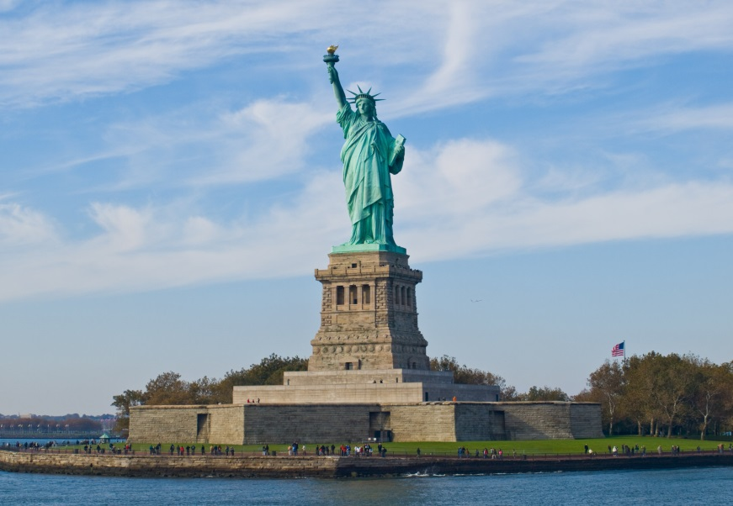
Country:
Nationality:
United States of America ( USA)
American

Slide 11

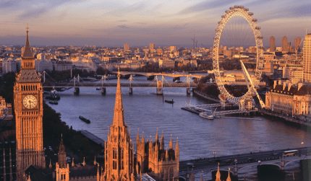

England
Country:
Nationality:
English/ British

Slide 12

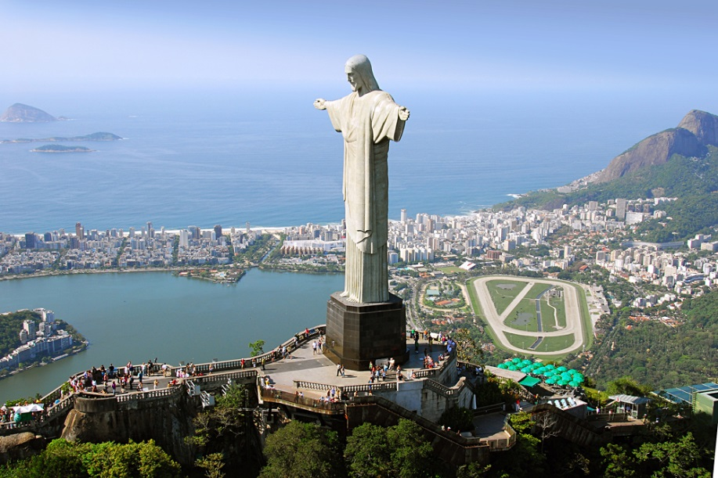
Country:
Nationality:
Brazil
Brazilian

Slide 13

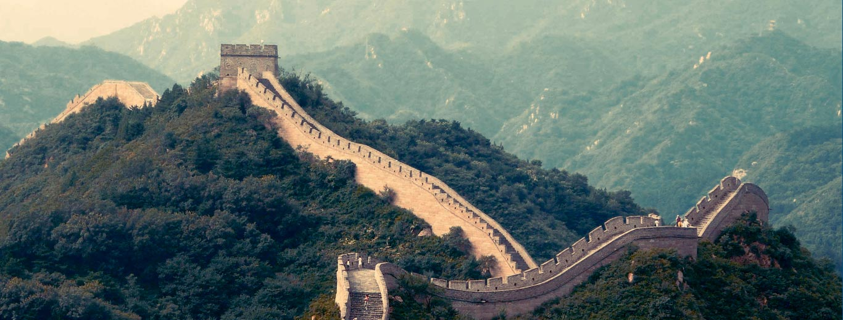
Country:
Nationality:
China
Chinese

Slide 14


Canada
Country:
Nationality:
Canadian

Slide 15
Monuments

Slide 16
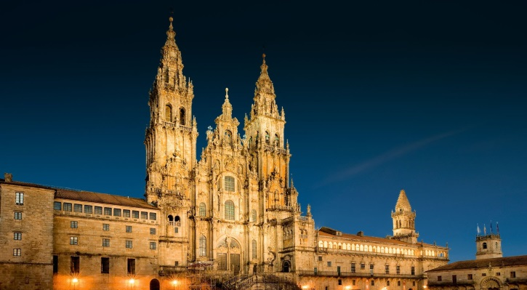

Spain
Portugal
Brazil
China

Slide 17


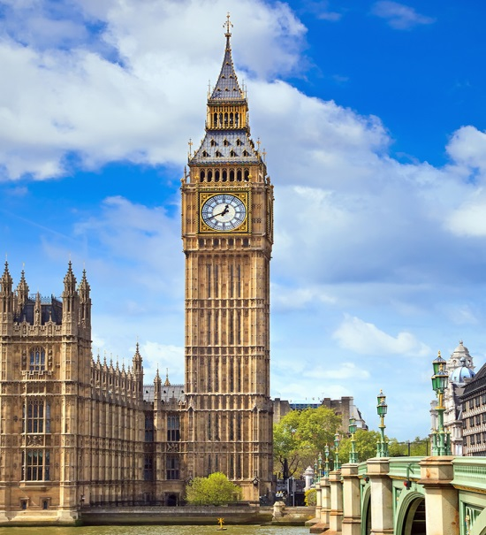
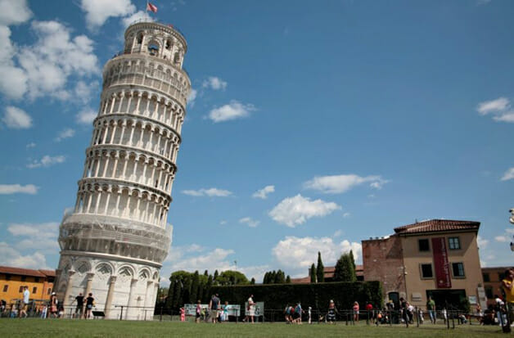
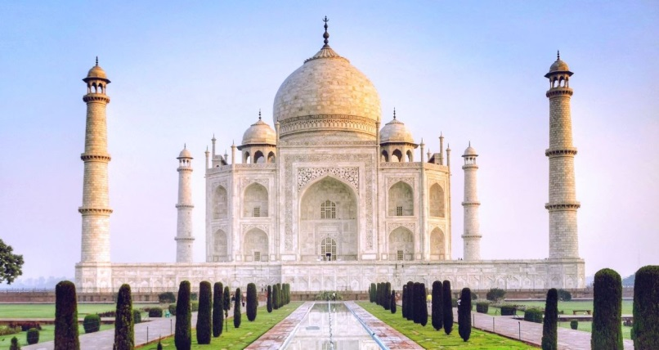
USA( New York)
Canada
England
Italy
India

Slide 18
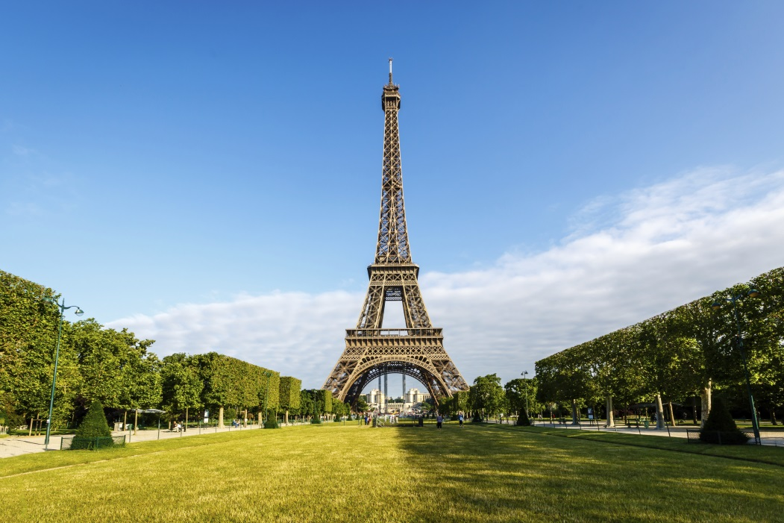
Hello Torre Eiffel.
I´m the Pisa Tower.
I´m from Italy, and I´m Italian.
Hi!
I´m the Eiffel Tower.
I´m from France, and I´m French

Slide 19
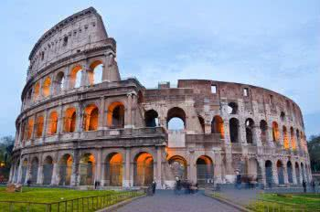
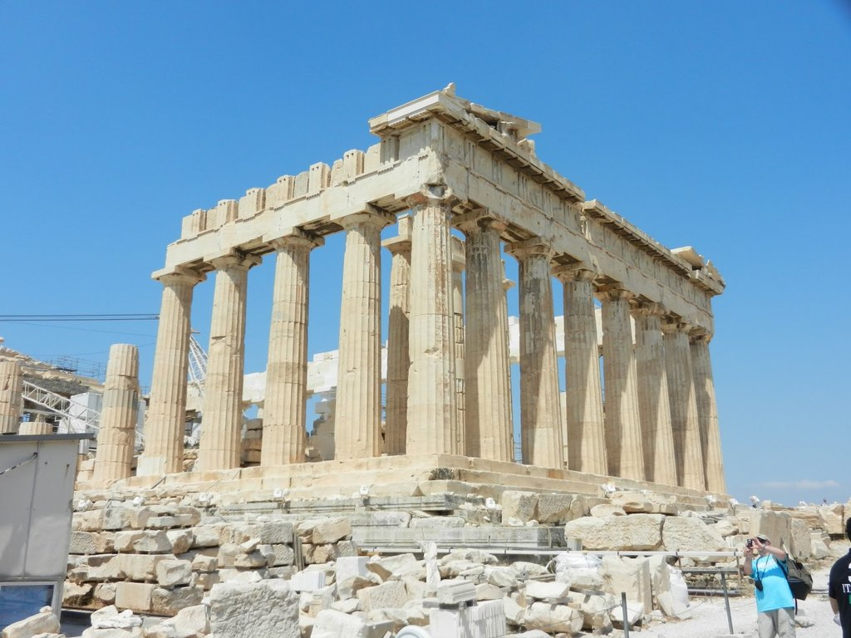
Hello!
I’m from , I’m
!
My country is very cute!
Hi!
I’m from .
I’m
Italy
Greece.
Italian
Greek.

Slide 20
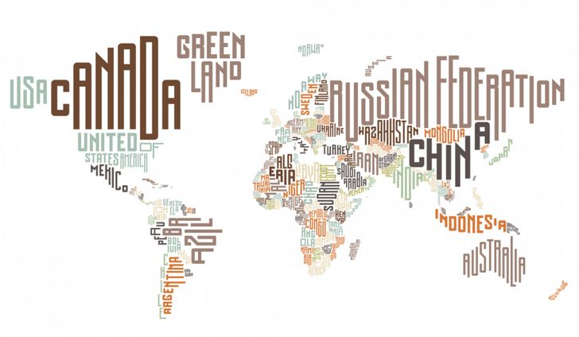

THE END
Luana Martins e Renato Rocha | 6º F

